Slide 1
Nutrient Rich and Efficient Cooking
Simplify your life in the kitchen, and stay healthy too!

Slide 2
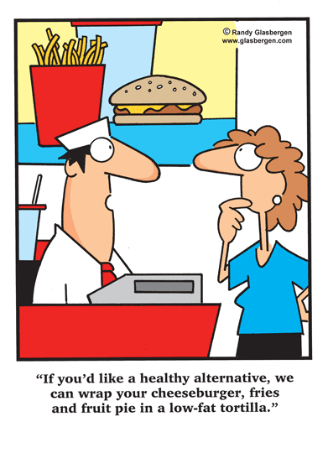

Slide 3

Benefits of Cooking
Less food is wasted
More variety
More nutrients
Generally less sodium, saturated fat, and trans-fat

Slide 4

Eating out- How much does it really cost?
How much food is left on your plate?
$
Variety
Nutrition

Slide 5
Favorite Foods
With a neighbor, share your favorite food from each food group and why.
Share your favorite meal too!

Slide 6
Tips and Tricks
Make slightly larger meals once, and you can save leftovers for a second meal another day
Stir-frying or steaming vegetables
Fruits & Vegetables in all forms (fresh, frozen, and canned)
Fresh fruit benefits?
  Added fiber into your diet

Slide 7
Efficient Cooking and Storage
Making large meals and freezing half of it
Plan meals before grocery shopping
Buy frozen vegetables
Only purchase as much as you can eat

Slide 8
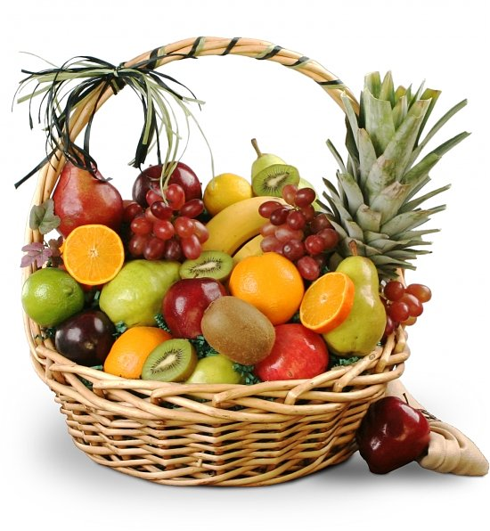
Favorite Fruit
Write down your favorite fruit and discuss with a neighbor what it is and why.

Slide 9
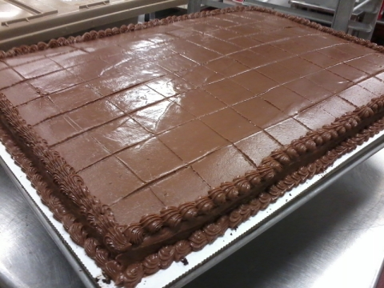
Taste Testing Time!
Chocolate cake….. ☺

Slide 10
Healthier Substitutes
Oil → Applesauce
  Benefits: Added serving of fruit, lower fat content
Cheeseburger →Home-made burger or other sandwich
  Benefits: Lower in sodium and saturated fat
Cream cheese → Neufchatel cream cheese
  Benefits: Lower saturated fat, or fat in general

Slide 11
Healthier Substitutes cont.
Less saturated fat and trans fat
  Lean meat instead of regular meat
Low-fat or fat free items
  Fat free or low-fat sour cream or milk
Low sodium
  Look for frozen items with low sodium
  More vegetables= More health!

Slide 12
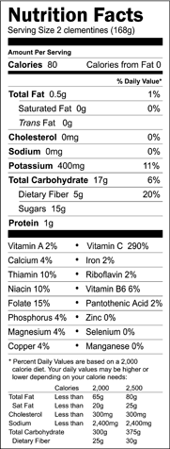

Nutrition Labels

Slide 13
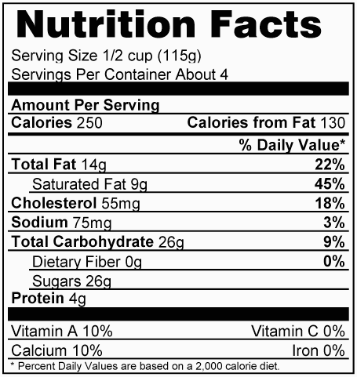

Slide 14
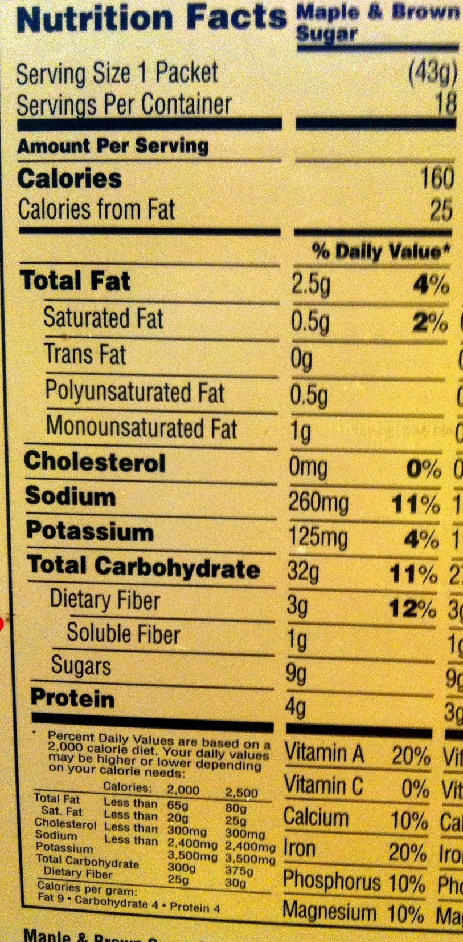
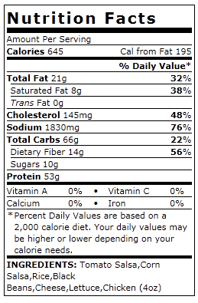

Slide 15
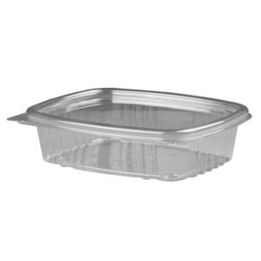
How to Freeze Food Safely
Small disposable containers
Single servings
Liquids, 2-inch deep containers
Label and date
Single servings

Slide 16

Make a Goal
Choose one or two things you would like to do THIS week!
Write them down, and put them on your fridge so you can remember your goal(s).
Ideas?

